Slide 1
Uplift Model

Slide 2
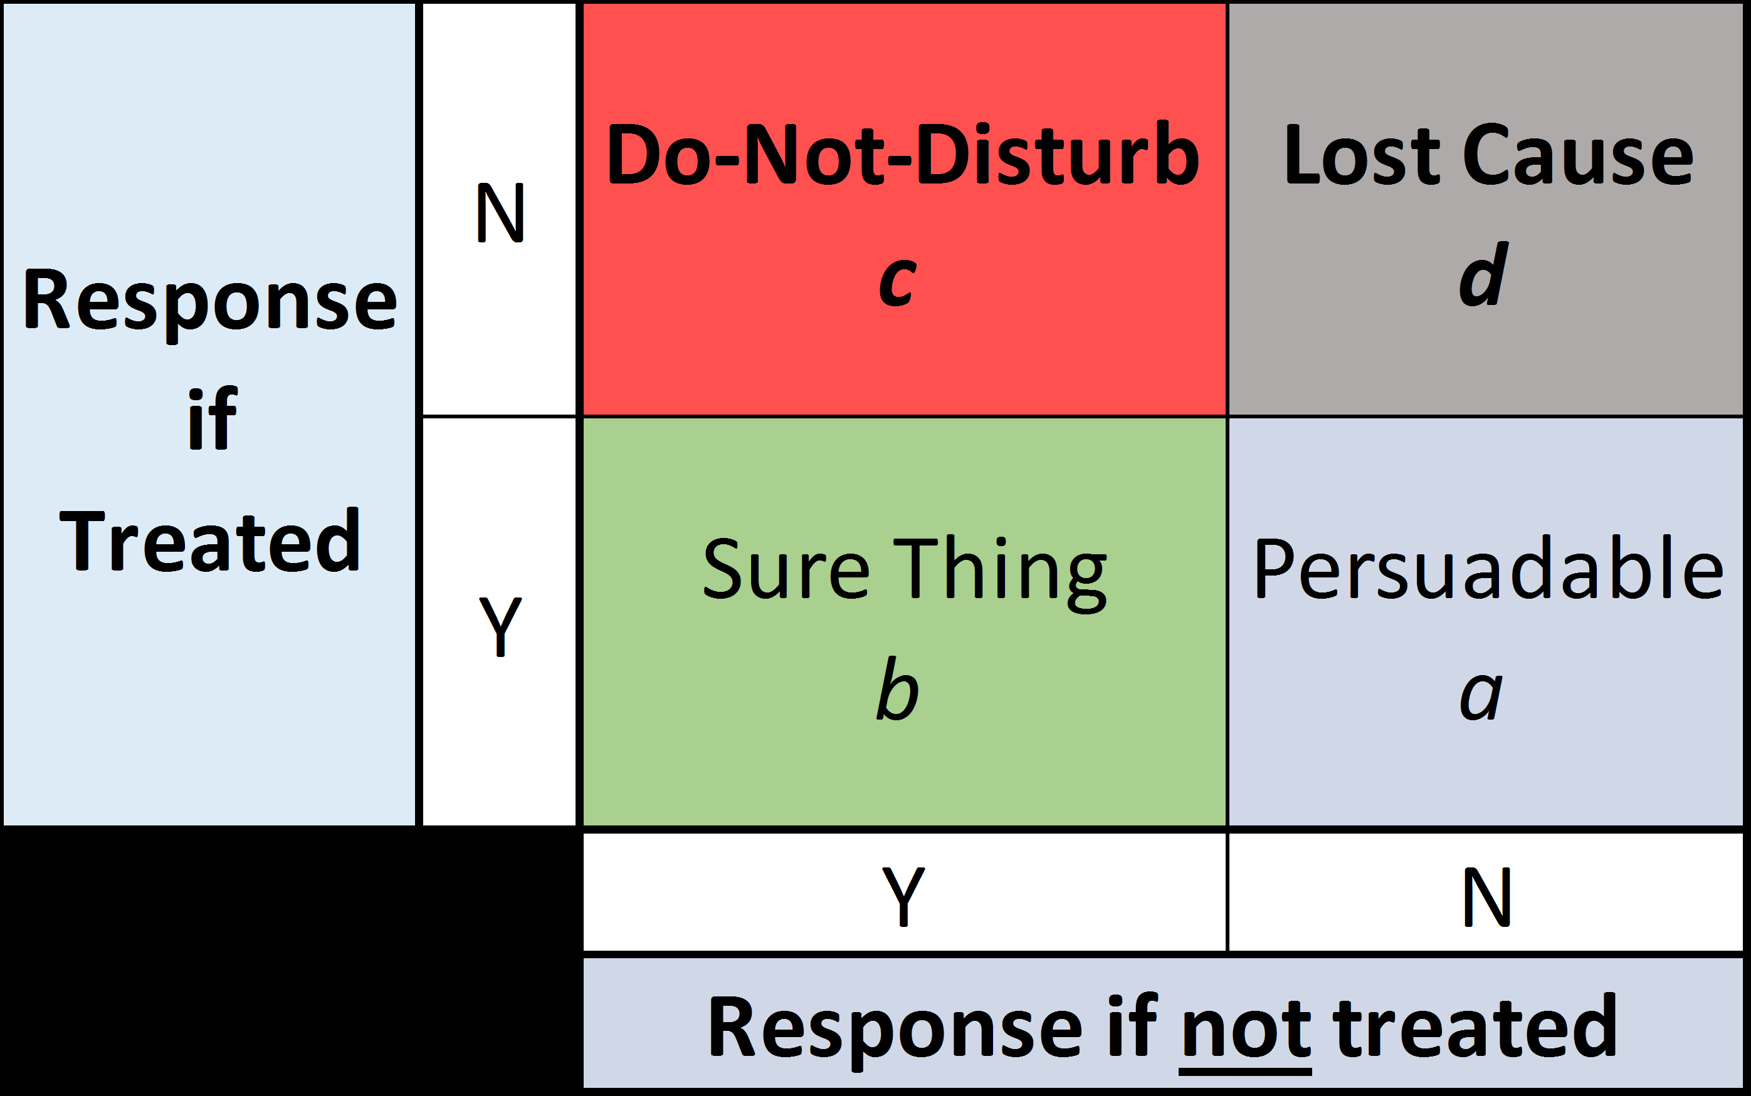
Objective of Lift model
With the traditional response model, we can not distinguish those will respond no matter if they were treated or not (Sure Thing) from those that only responded because of the treatment (Persuadable).
The objective of Uplift modeling is to identify the Persuadables and target them in promotion.
Resources:
https://www.researchgate.net/publication/270217235_Identifying_Individuals_Who_Are_Truly_Impacted_by_Treatment_Introduction_to_Recent_Advances_in_Uplift_Modeling
https://medium.com/datadriveninvestor/simple-machine-learning-techniques-to-improve-your-marketing-strategy-demystifying-uplift-models-dc4fb3f927a2

Slide 3
Metrics
Incremental Response Rate | RR of mailed - RR of control
Net Incremental Revenue | (premium*mailed conversions-cost per send * mailed) - premium*control conversion

Slide 4
Traditional Approach
Goal : To separate those who are likely to respond vs those who are less likely to respond to a promotion.
A,C and F,G are the Sure Thing! B,H are the Persuadables.
Think of it as a game…given that B & H are both Persuadables, our model is trying to identify H (Persuadables without promotion) by identifying B (Persuadables with promotion).
Approach:
1. Mark A/B/C as 1 and the rest (D to J) as 0. Up-sample the training data.
2. Train the model on the entire dataset. If the model identify 1 then send promo, if 0 we do not send promo
Reason why it works:
- With the old response model, normally we will build it based on all responders (A,B, C, F, G), which means B is only 20% of the responders. With the new approach, we only identify A, B, C as responders, now B accounts for 33% of the responders, meaning that the model is more likely to capture B&H in the validation dataset.
 | Audience
Treat | A | B | C | D | E
Control | F | G | H | I | J
* Highlight in green means that the customer responded

Slide 5
Two Models Approach
Goal : To identify those that are more likely to respond to a promo by subtracting the scores out of 2 models.
Again, A,C and F,G are the Sure Thing!, B,H are the Persuadables.
Approach:
Train a model on treated group (Model #1) and another on control group (Model # 2).
Apply both Model #1 and Model # 2 on the same person in validation dataset.
Lift = score of model #1 – score of model #2.
The Persuadables are the ones with higher lift ( bigger difference in the score).
Reason why it works:
Given that B is considered a responder in Model # 1, a customer with similar attributes will receive a higher score in Model # 1. On the other hand, H is considered a non-responder in Model # 2, a customer with similar attributes will receive a lower score in Model # 2.
The lift of a customer similar to B will be higher than the lift of a customer similar to A, C that receive high score in both models.
 | Audience
Treat | A | B | C | D | E
Control | F | G | H | I | J
* Highlight in green means that the customer responded
Notes:
Downside: The two model approach models lift indirectly. While both models might accurately model the probabilities of response in either the treatment or the control group, the difference in the probabilities of the two models may not capture the lift precisely.
Differences in scales of the two models could be responsible for this phenomena. In addition, the amount of error could be doubled since both the treatment model and the control model will contribute errors.
Pros: simple concept, familiar execution (x2)
Cons: indirectly models uplift, the difference may be only noise, 2x the work,
scales may not be comparable, 2x the error, variable reduction done on indirect
dependent vars

Slide 6
Single Model Approach
Goal : To identify persuadables by subtracting the scores from a single model in 2 circumstances : receive and not receive a promo.
Again, A,C and F,G are the Sure Thing!, B,H are the Persuadables.
Approach:
Train a model on both treated group and control group. Set a treatment indicator as 1 for treated group and 0 to control group.
Apply the model to a new customer (validation set) by setting 1 to treatment indicator, and runs the model again by setting 2 to treatment indicator.
Lift = (score of model with treatment =1 ) – (score of model with treatment =0).
The Persuadables are the ones with higher lift ( bigger difference in the score).
Reason why it works:
B (treatment indicator set as 1 in the model) will receive a higher score than H (treatment indicator as 0 in the model) because B was a responder and H was not.
A new persuadable with similar attributes to B will follow the same pattern and receive a higher score if marked as treated in the model and a lower score just like H if marked as not treated in the model
The lift of a customer similar to B,H will be higher than the lift of a customer similar to A, C that receive high score in both circumstances.
 | Audience|Treatment Indicator|Score
Treat | A |1|90 | B|1|88 | C|1|87 | D|1|62 | E|1|55
Control | F|0|89 | G|0|90 | H|0|60 | I|0|61 | J|0|59
Lift of a ‘Sure Thing’ (A-F)=90-89=1
Lift of a ‘Persuadables’ (B-H)=88-60=28
* Highlight in green means that the customer responded
Notes:
=x+1*x+

Slide 7
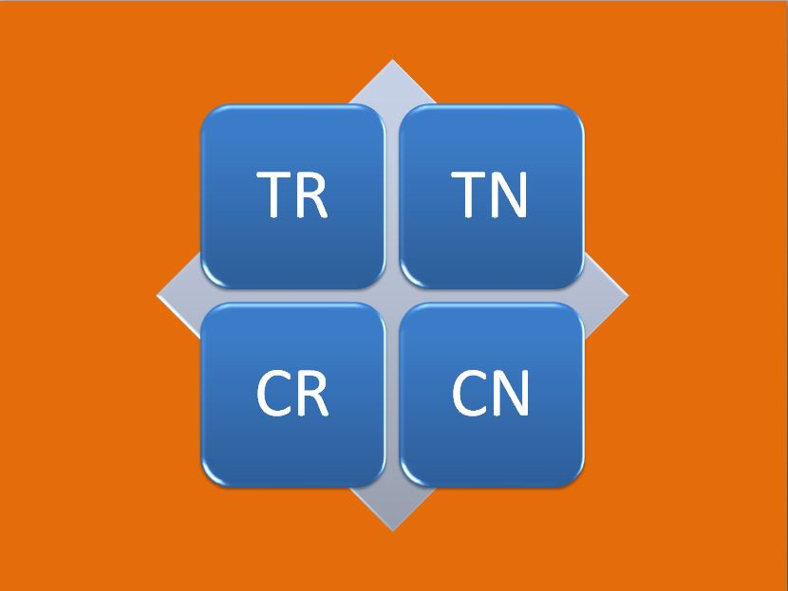
Four Quadrant Approach
Goal : Multi-class classification model with four classes. Simply classify the customers into 4 categories(quadrants) and target the TR (Treatment and Response) that are classified by the model.
A,C and F,G are the Sure Thing! B,H are the Persuadables.
Approach:
1. Classify the groups into 4:
TR: the treatment and response group. Individuals in this group received a treatment (promotion) and responded (made a purchase)
CR: the control and response group. Individuals in this group received no treatment (no promotion) but still responded (made a purchase)
TN: the treatment and no response group. Individuals in this group received a treatment (promotion) but did not respond (made no purchase)
CN: the control and no response group. Individuals in this group received no treatment (no promotion) and did not respond (made no purchase)
2. If a model predicts that an individual belongs to class TR then we send a promotion.
Reason why it works:
- Simply targeting the Treat/Respond group will raise the % of B in the responders, which means they are also more likely to capture H, similar concept to the first traditional approach.
Treatment | Respond | No Respond
Treat | A,B,C | D,E
Control | F,G | H,I,J
Notes:
downside

